Slide 1

The OpenAI API
A Brief Introduction

Slide 2
Introduction
“The OpenAI API can be applied to virtually any task. We offer a range of models with different capabilities and price points, as well as the ability to fine-tune custom models.”
https://platform.openai.com/docs/introduction

Slide 3
What is an API
How Applications Communicate

Slide 4
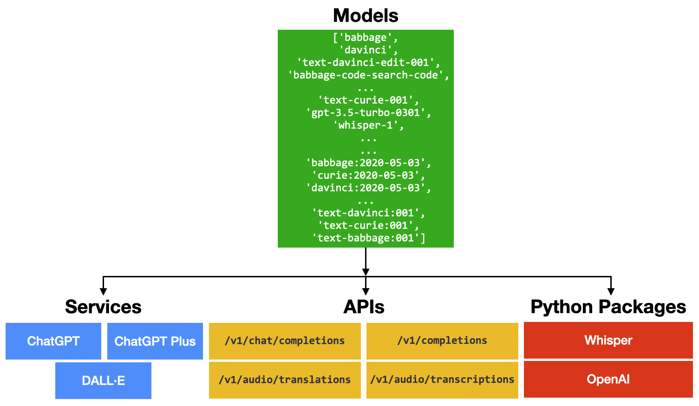
Services vs APIs vs Packages
Notes:
Services: This is for end-users who want to make use of AI to do their daily work.
APIs: This is for developers who want to integrate OpenAI's services into their applications.
Python packages: This is specifically for Python developers to use OpenAI's services.
https://www.codemag.com/Article/2307041/An-Introduction-to-OpenAI-Services

Slide 5
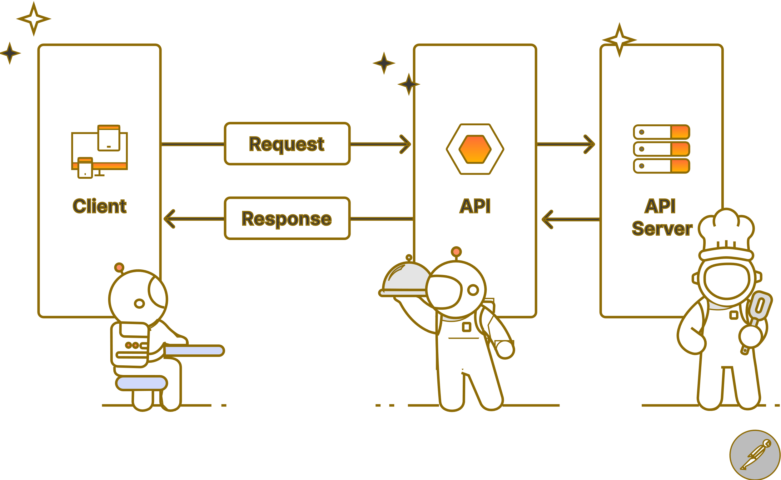
How APIs Work
Notes:
https://www.postman.com/what-is-an-api/

Slide 6
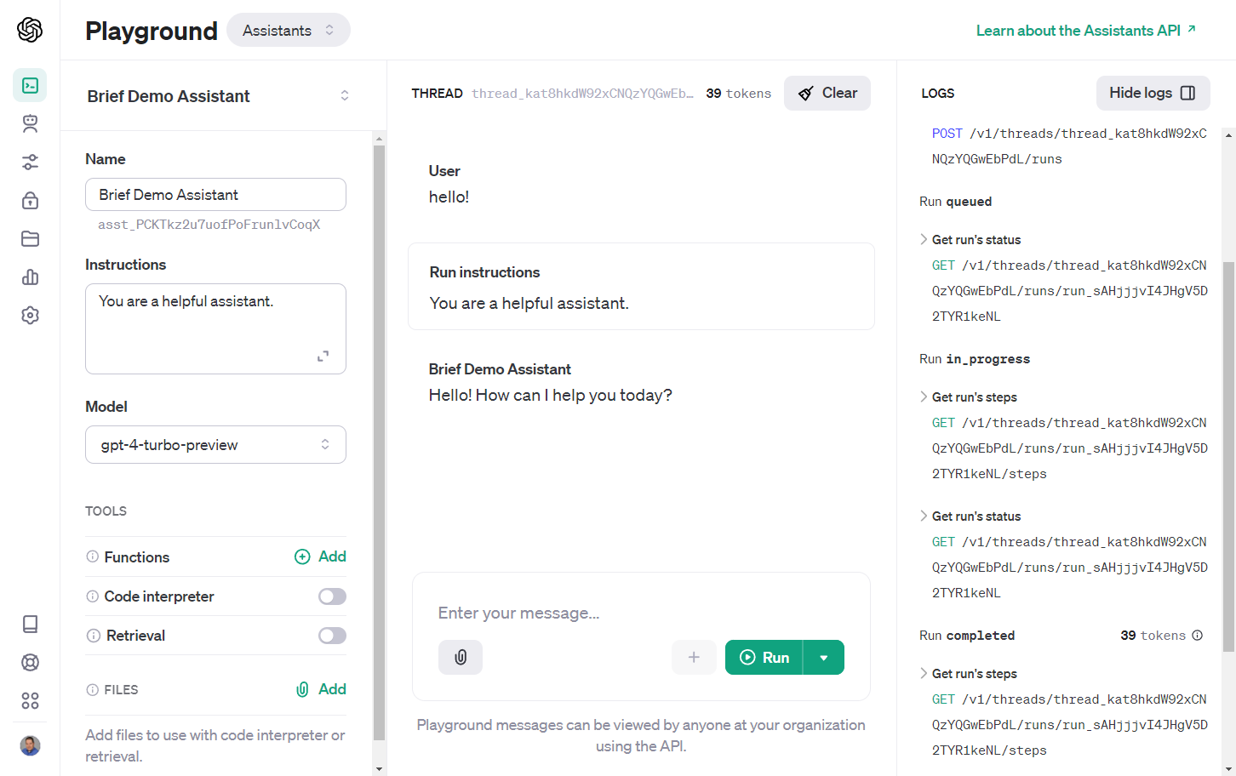
OpenAI API Example: Assistant

Slide 7
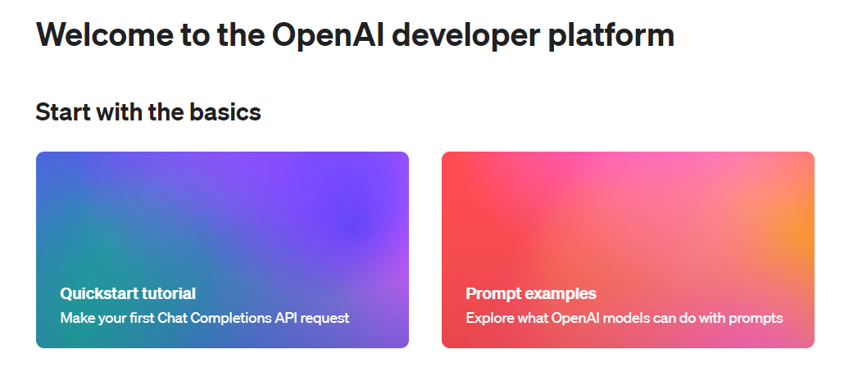
Getting Started
Setting Up an Account
Notes:
https://platform.openai.com/

Slide 8
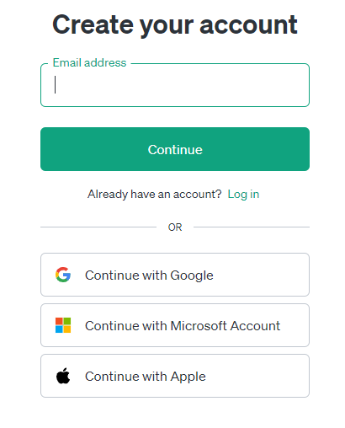
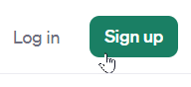
Registration
Notes:
https://platform.openai.com/signup

Slide 9
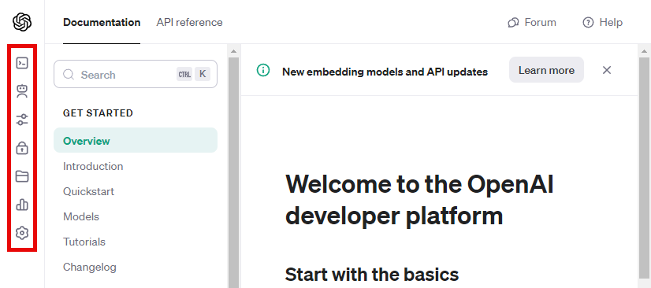
Logging In

Slide 10
Exploring the Settings
Key Settings to Change

Slide 11
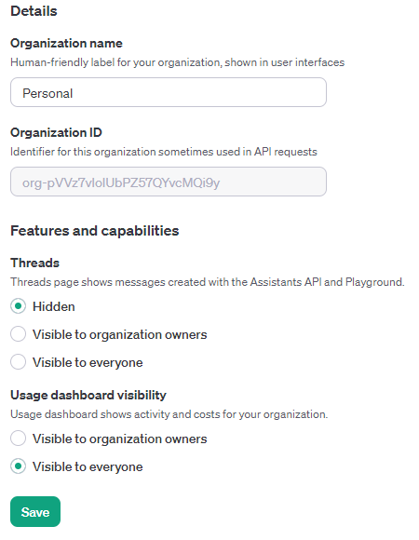
Organization
Notes:
https://platform.openai.com/account/organization

Slide 12
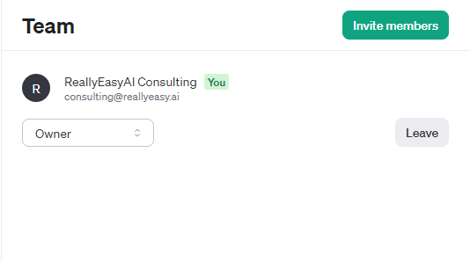
Team

Slide 13
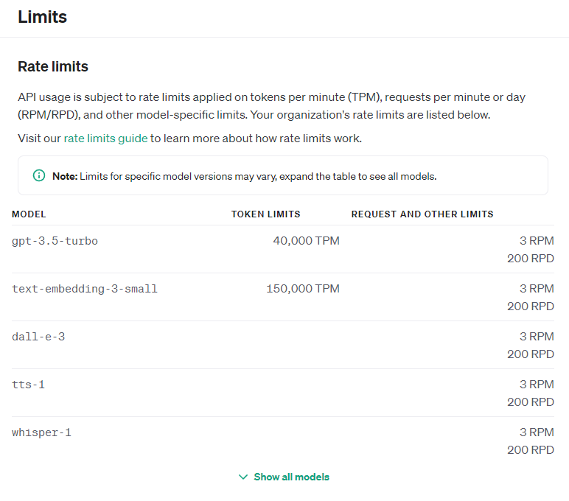
Limits

Slide 14
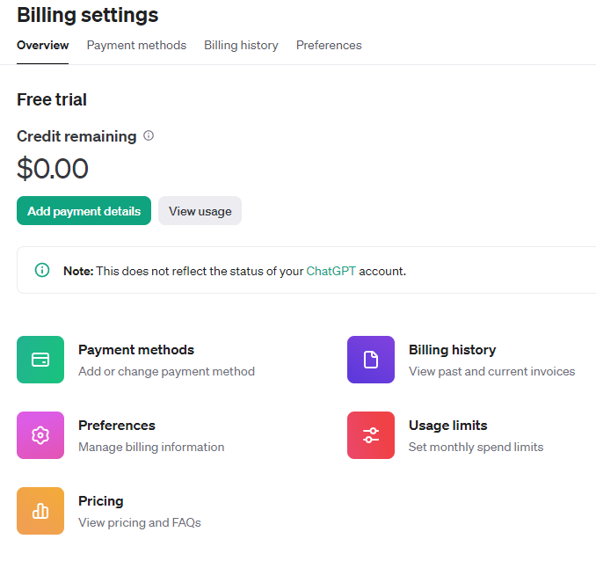
Billing

Slide 15
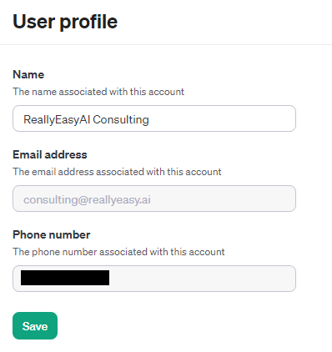
Profile

Slide 16
Understanding Billing
API Usage Credits

Slide 17
Free Trial API Credits
When you create a new account OpenAI grants 5$ in free credits that you can use within three months before they expire.
After that you will have to supply credit card details and purchase credits in advance before using them.
Phone numbers associated with an existing account will not receive additional free credits.
After the credits are used you will need to supply a payment method.

Slide 18
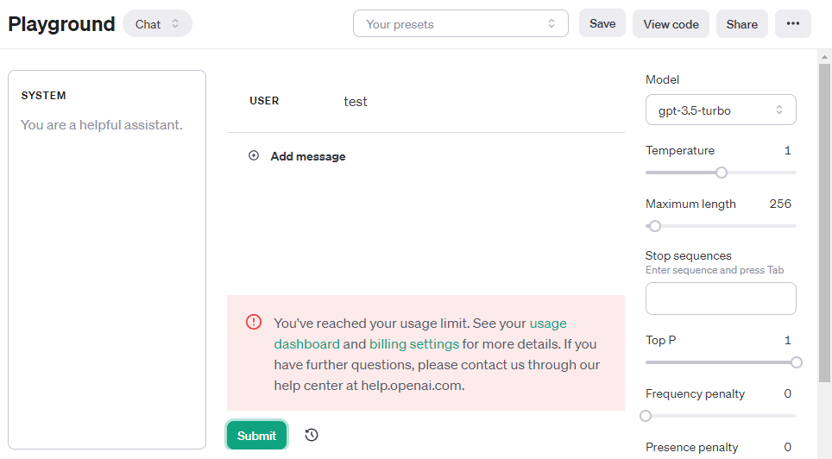
Your First Brick Wall
Notes:
https://platform.openai.com/playground

Slide 19
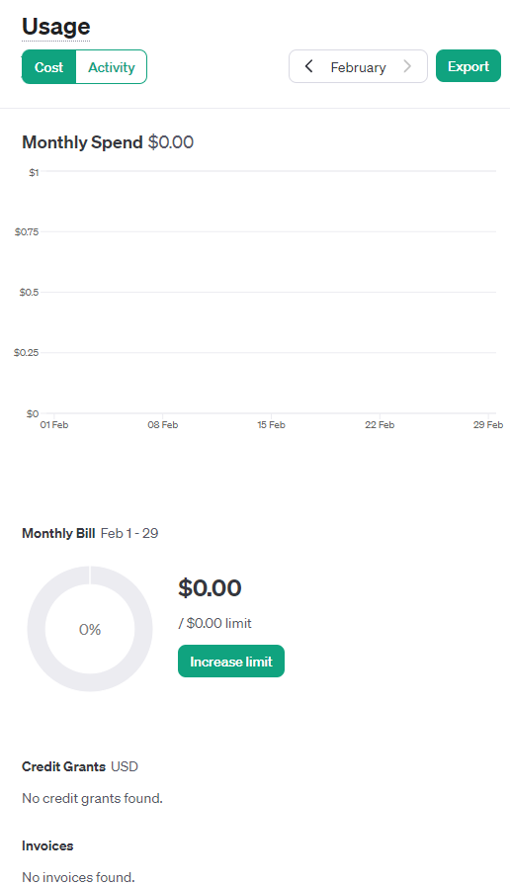
Usage Explained
Notes:
https://platform.openai.com/usage

Slide 20
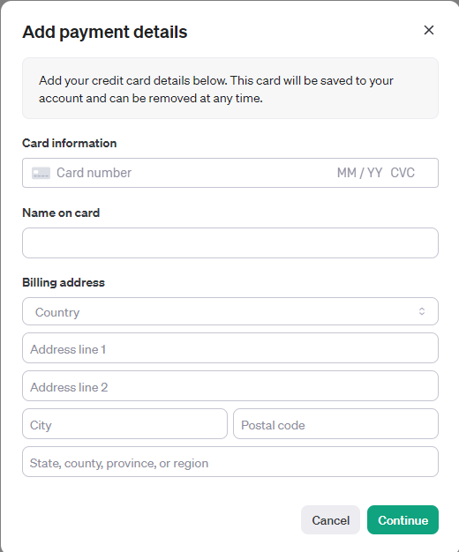
Pay to Play

Slide 21
Usage Tiers
Leveling Up Your Model Usage

Slide 22
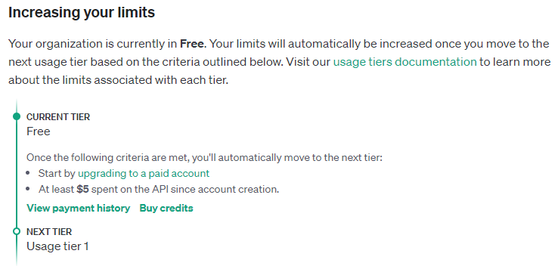
Starting at Free
Notes:
https://platform.openai.com/account/limits

Slide 23
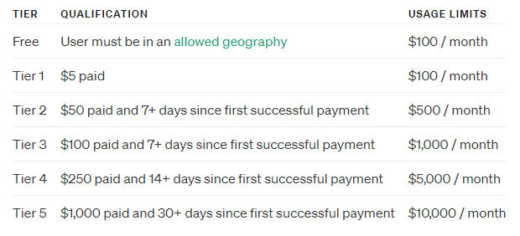
How to Level Up
Notes:
https://platform.openai.com/docs/guides/rate-limits/usage-tiers?context=tier-free

Slide 24
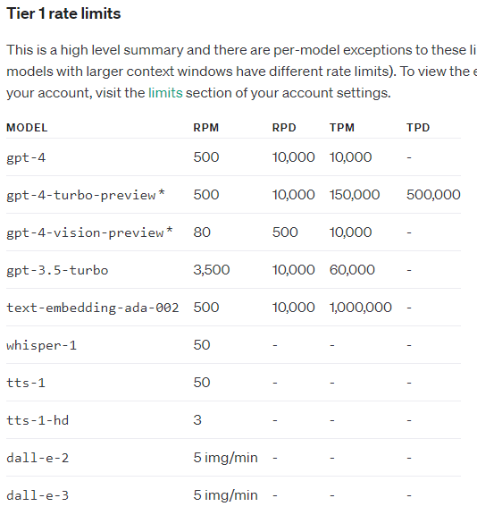
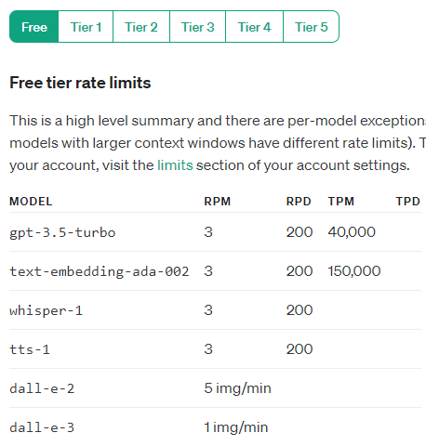
Why Level Up?

Slide 25
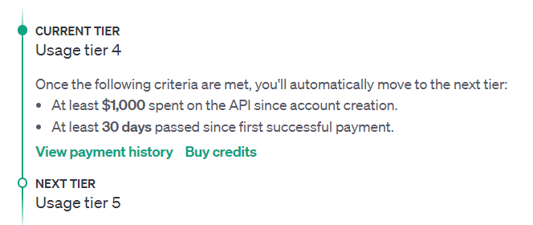
How High Should You Go?

Slide 26
Your First Chat
Having Fun in the Playground

Slide 27
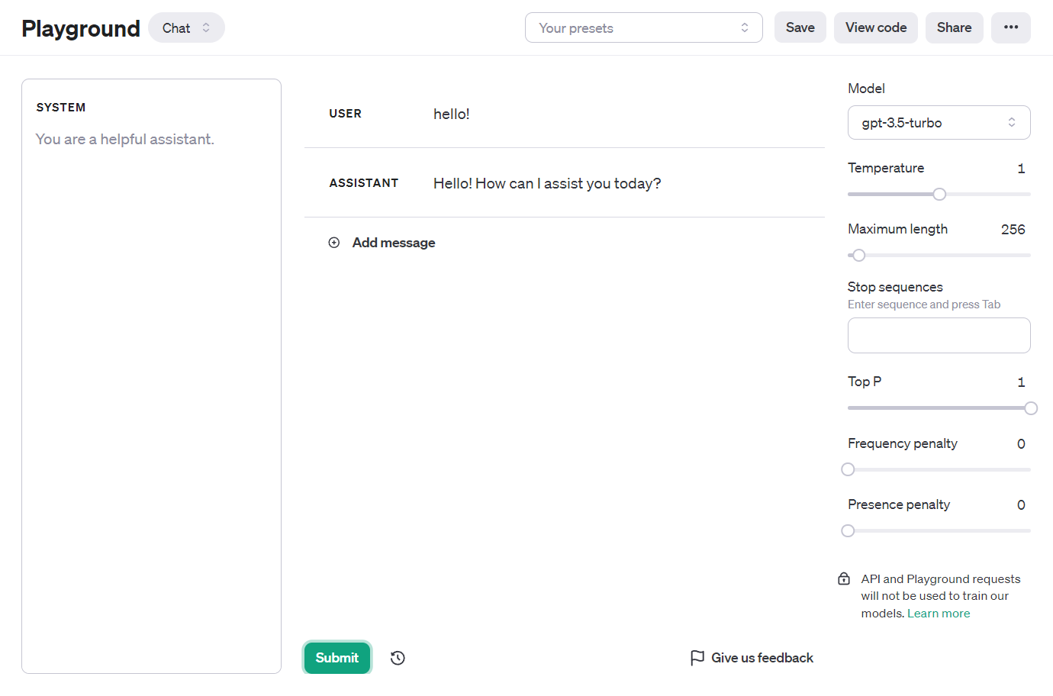
Notes:
https://platform.openai.com/playground?mode=chat

Slide 28


